Slide 1
Pitch for #dialect directive
N3407
2025-01-13
Jakub Łukasiewicz
Communicates what dialect code was written for
Standardizes staple part of build systems
Mitigates negative effect of breaking changes
* for now, primarily addresses the core language; standard library later

Slide 2
Principles to not break old code
9. Minimize incompatibilities with C90 (ISO/IEC 9899:1990). It should be possible for existing C implementations to gradually migrate to future conformance, rather than requiring a replacement of the environment. It should also be possible for the vast majority of existing conforming C programs to run unchanged.
~ N444
14. Migration of an existing code base is an issue. The ability to mix and match C89, C99, and C1X based code is a feature that should be considered for each proposal.
~ N1250
Ease migration to newer language editions
Developers should be able to mix and match code from different language editions. The bulk of existing codebases should be largely accepted by a translator conforming to a newer language revisions, and the programmer's burden to change code just to have it accepted by a conforming translator must be limited.
~ N3280

Slide 3
PROBLEM

Slide 4
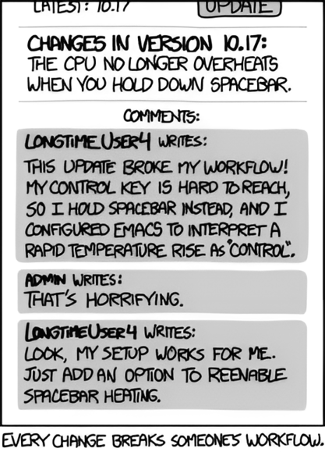
One’s bug is another’s feature
https://xkcd.com/1172/

Slide 5
One's trash is another's treasure
struct Ctx { void (*last)(); };
extern void *HIST;
extern void list_append(void*, void (*)());
void bar(int);
void baz(int,int*);
void (*EXCLUDED[100])() = { &bar, &baz };
void hist_append(struct Ctx *ctx)
{
for (int i = 0; i < 100; ++i) {
if (ctx->last == EXCLUDED[i]) {
return;
}
}
list_append(HIST, ctx->last);
}
(broken in C23)

Slide 6
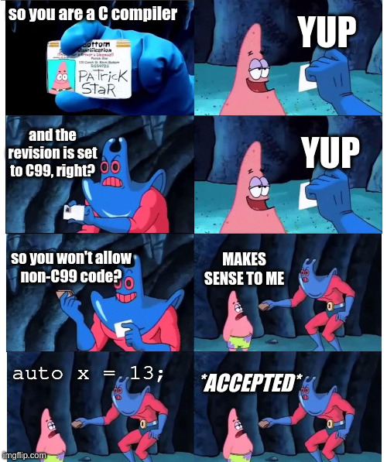
On the other hand...

Slide 7
$ cat a.c
int main()
{
auto x = 13;
return 0;
}
$ gcc -std=c99 a.c
Debian < 12 | * | success?!
Arch Linux | before May 2024 | success?!
It doesn’t even say it’s been removed!
a.c:3:10: warning: type defaults to 'int' in declaration of 'x' [-Wimplicit-int]
3 | auto x = 13;
|

Slide 8
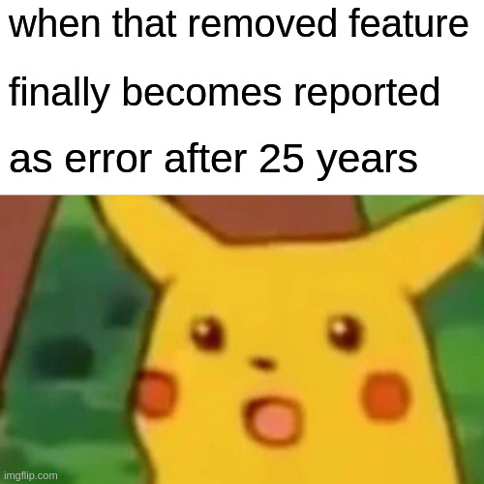

Slide 9
$ cat a.c
int main()
{
auto x = 13;
return 0;
}
$ gcc -std=c99 a.c
Debian 12 | * | success
Debian 13 | * | failure?!
Arch Linux | before May 2024 | success
 | after May 2024 | failure?!

Slide 10
$ cat a.c
int main()
{
auto x = 13;
return 0;
}
$ gcc -std=c99 a.c
Should be:
* | * | failure!

Slide 11
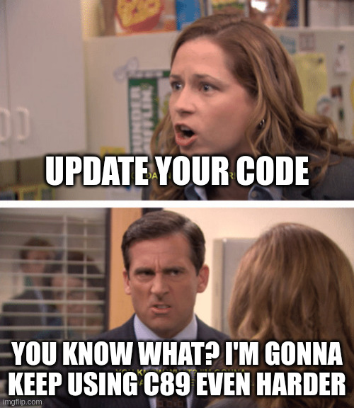
Folks like their old C standards

Slide 12
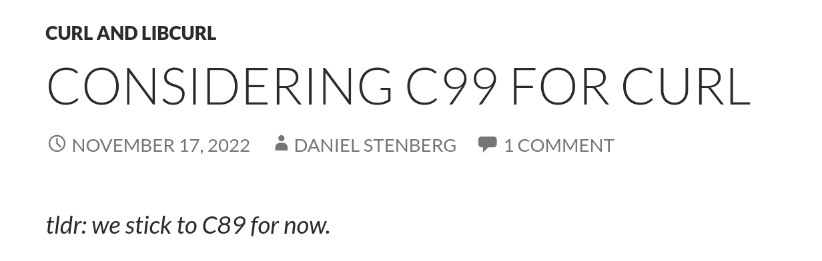
Folks like their old C standards
https://daniel.haxx.se/blog/2022/11/17/considering-c99-for-curl/

Slide 13
And "if it ain't broke, don't fix it"
Fixing style violations while working on a real change as a preparatory clean-up step is good, but otherwise avoid useless code churn for the sake of conforming to the style.
"Once it _is_ in the tree, it's not really worth the patch noise to go and fix it up."
Cf. https://lore.kernel.org/all/20100126160632.3bdbe172.akpm@linux-foundation.org/
https://git.kernel.org/pub/scm/git/git.git/tree/Documentation/CodingGuidelines

Slide 14
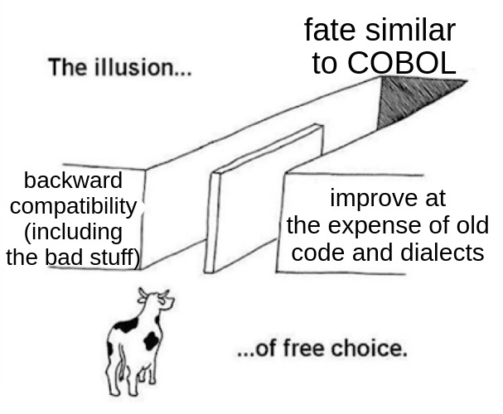
The dilemma C faces
* "slightly" exaggerated for dramatic effect

Slide 15
SOLUTION

Slide 16
#dialect directive
a piece of metadata telling the compiler under which rules the code was written
or: #version, #lang, #ver, #std, etc.

Slide 17
What does it entail?
pre-processor directive #dialect
  propagates to included files
  does not propagate back
  emits diagnostic on unsupported dialects
    the standard itself requires only support of its own revision
    implementation that offer partial support recommended to display warning listing unsupported features or what conflicts it has
way to query for currently active dialect,
as well as available ones (e.g. __has_dialect)
attribute for marking objects as dialect “exclusive”
  + figuring out the best way to handle library features available conditionally by dialect
Optional / further additions / to consideration
analogous pragma, but which propagates back
push and pop functionality
user-defined dialects a la D’s versions?

Slide 18
Rules
For the sake of simplicity the examples across this document use rather loose set of rules for the directive. The final feature will be surely defined more robust*, something akin to:
Unless specified in other way, if preceded only by comments, #if and #define directives, the first #dialect directive sets base dialect for the translation unit.
  If no dialect is set explicitly before the first non comment, #if or #define, then value of dialect is implementation defined.
No dialect based on higher version of C standard than the one set as the base dialect shall be used within the TU.
#dialect directive shall appear only on file scope.
Dialect value shall be carried into included files.
After finishing processing of included file, dialect value from before inclusion shall be restored.
* The final syntax as well ought to provide finer level of control and precision.

Slide 19
An example way how could it work
// effect of -std= flag
#dialect C2y
#include "lib.h.c"
#dialect C89
static x = 0;
#dialect C2y
int main()
{
// puts(strsignal(0));
print_signal_str(0);
}
/* lib.h.c */
#dialect POSIX2024
#include <stdio.h>
#include <string.h>
static void
print_signal_str(int s)
{
puts(strsignal(s));
}

Slide 20
The directive communicates to compiler what assumptions were made by programmer.
The behaviour is still the same as before:
implementation defined
but now explicitly, instead of implicitly.

Slide 21
PRIOR ART
* non-extensive list

Slide 22

Existing C features
#pragma
=
-std=
#dialect
#if __DIALECT__
__STDC_VERSION__
#define _POSIX_C_SOURCE 200809L
#bind ?

Slide 23
Perl
sub say {
my ($input) = @_;
print "$input World!\n";
}
say("Hello");
*old_say = \&say;
use v5.10; # Perl 5.10 added 'say'
say("Hello");
old_say("Hello");
Output:
  Hello World
  Hello
  Hello World

Slide 24
Many languages have official way to specify project’s language version, e.g.:
Rust’s editions
Swift’s swift-tools-version comment
D’s versions
Ruby’s ruby keyword in Gemfiles

Slide 25
Many have way to specify minimal required version, e.g.:
C’s #if __STDC_VERSION__ >=
C++’s #if __cplusplus >=

Slide 26
BENEFITS
What problems does it solve?
What improvements and fixes it enables?
Disclaimer:
Examples on the following slides aren’t meant to be perfectly accurate, but to convey the idea.

Slide 27
(tiny) step towards simpler build systems

Slide 28
(tiny) step towards simpler build systems
Especially for techniques like:
unitary builds,
X-Files,
subtree dependencies,
etc.

Slide 29
Correct diagnostics for single files
int bar();
void foo()
{
bool b1 = {};
_Bool b2 = false;
int *p = nullptr;
bar(1);
JUMP:
int x = {};
goto LABEL;
{
LABEL:
}
int a = 11'11;
if (a+x && b1 && b2 && p)
goto JUMP;
}
(default linting of C23 code by clangd 19.1.6)

Slide 30
Correct diagnostics for single files
int bar();
void foo()
{
bool b1 = {};
_Bool b2 = false;
int *p = nullptr;
bar(1);
JUMP:
int x = {};
goto LABEL;
{
LABEL:
}
int a = 11'11;
if (a+x && b1 && b2 && p)
goto JUMP;
}
/* compile_commands.json */
[
{
"command": "cc -std=c23 -c x.c",
"directory": "/path/to/dir",
"file": "x.c"
}
]
Manually written, because build fails!
← had to be saved on disk

Slide 31
Correct diagnostics for single files
#dialect C23
int bar();
void foo()
{
bool b1 = {};
_Bool b2 = false;
int *p = nullptr;
bar(1);
JUMP:
int x = {};
goto LABEL;
{
LABEL:
}
int a = 11'11;
if (a+x && b1 && b2 && p)
goto JUMP;
}

Slide 32
No need to constantly change flags when testing features across implementations e.g. on Compiler Explorer

Slide 33
No need to constantly change flags when testing features across implementations e.g. on Compiler Explorer
#define C99
int main()
{
_Bool b = 0;
return 0;
}

Slide 34




It could also aid quality and style checkers?

Slide 35
No need for _UglyKeywords
#dialect C89
#include <lib_bool.h>
void (*my_bool)(int,int) = bool;
#dialect C23
int main()
{
bool x = false;
my_bool(13, 44);
return 0;
}
/* lib_bool.h */
void bool(int,int);
#include "lib_bool.h"
void bool(int a, int b)
{
int _Bool = a+b;
}
https://www.open-std.org/jtc1/sc22/wg14/26816

Slide 36
No need for _UglyKeywords
#dialect C23
#include <lib.h>
const auto lib_lengthof = lengthof;
#dialect C2y
void func()
{
auto n = lengthof (int[12]);
auto l = lib_lengthof(/* args */);
}

Slide 37
Full power of _Optional optional
/* old_lib.c */
void foo(int *p)
{
if (p) {
*p = 12;
}
}
#define NULL ((void*)0)
#include <old_lib.h>
#include <new_lib.h>
void func()
{
foo(NULL); // no warning (good?)
bar(NULL); // no warning (bad!)
}
/* new_lib.c */
void bar(int *p)
{
*p = 12;
}

Slide 38
Full power of optional
/* old_lib.c */
void foo(int *p)
{
if (p) {
*p = 12;
}
}
#define NULL ((optional void *)0)
#include <old_lib.h>
#include <new_lib.h>
void func()
{
foo(NULL); // false positive (bad)
bar(NULL); // warning (good!)
}
/* new_lib.c */
void bar(int *p)
{
*p = 12;
}

Slide 39
Full power of optional
/* old_lib.c */
void foo(int *p)
{
if (p) {
*p = 12;
}
}
#define NULL ((optional void *)0)
#dialect C23
#include <old_lib.h>
#dialect C2y
#include <new_lib.h>
void func()
{
foo(NULL); // info note (good)
bar(NULL); // error (very good!)
}
/* new_lib.c */
void bar(int *p)
{
*p = 12;
}

Slide 40
Removal of 0 as null (N3426 alt.1)
0 as null is common not only directly, but also through such idioms:
$ cat a.c
int main()
{
struct { int *ptr; int a; } foo = { 0 };
return 0;
}
$ gcc -Wzero-as-null-pointer-constant a.c
a.c: In function ‘int main()’:
a.c:3:34: warning: zero as null pointer constant
3 | struct { int *ptr; } foo = { 0 };
|
a.c:3:43: warning: ISO C forbids empty initializer braces before C23

Slide 41
Removal of 0 as null (N3426 alt.1)
/* old_lib.h */
#dialect C99
struct Foo {
char *name;
int number;
};
static inline void func()
{
struct Foo x = { 0 };
int *p = 0;
}
#dialect C2y
#include <old_lib.h> // fine
int main()
{
struct Foo y = {};
struct Foo z = {0}; // err
int *ptr = 0; // err
}
Avoids repeat of mess like with implicit int;
benefits available immediately for new, and refactored code.

Slide 42
Finally -Wwrite-strings by default?
#include <stdio.h>
#define PRINT_STR_TYPE() \
puts(_Generic("", \
const char *: "const char *", \
char *: "char *" \
))
#dialect C99
void foo99()
{
PRINT_STR_TYPE();
}
#dialect C2y
void foo2y()
{
PRINT_STR_TYPE();
}
int main()
{
foo99(); // out: "char *"
foo2y(); // out: "const char *"
return 0;
}

Slide 43
The auto shenanigans
While implicit int officially was removed in C99, in practice major implementations didn’t follow suit.
Until very recently no error was raised, only warnings without any mentioning of even deprecation.
Therefore, albeit small, there is non 0% chance for snippets like
auto x = pow(f,2);
to cause subtle, and difficult to detect, yet potentially disastrous changes in behaviour of the code.
#include <stdio.h>
#include <math.h>
#dialect C89
int idx(float f)
{
auto x = pow(f,2);
auto y = pow(f,3);
return x+y;
}
const char *secret[] = {
"1", "2", "3", "4", "5",
"6", "7", "8", "9", "10"
};
#dialect C23
int main()
{
auto i = idx(1.7);
puts(secret[i]);
return 0;
}
Without #dialect C89,
prints “8” instead of expected “7”!

Slide 44
Non-obtrusive warnings for obsolete octals
/* mod.h */
int mod = 0602;
#dialect C89
#include <mod.h> // no warning
#dialect C2y
int day = 01; // warning
int month = 02; // warning
int year = 2025;
int new_mod = 0700; // warning

Slide 45
Attributisation of restrict
restrict keyword has characteristics of attributes and probably ought to be redefined as such,
but for very unlikely scenario of somebody relaying on it being a qualifier:
#define foo(X) _Generic((X), \
int * restrict: "123", \
int *: "456" \
)
#dialect Weird-C23
void bar(int * p, int * restrict r)
{
puts(foo(p)); // 456
puts(foo(r)); // 123
}
#dialect C23
void baz(int * p, int * restrict r)
{
foo(r); // warning: ... association 'int *restrict' will never be selected
}
#dialect C2y
void bay(int * restrict r); // warning: using `[[restrict]]` attribute

Slide 46
Fixing/improving decay to pointer?
#dialect C99
void foo99(int *arr, int n);
void bar99(int arr[], int n);
#dialect C2y
void foo2y(int *ptr, int n);
void bar2y(int arr[], int n);
void foo()
{
int a[] = { 1, 2, 3 };
int *p = nullptr;
foo99(a, lengthof a); // no error, maybe warning
bar99(a, lengthof a);
foo99(p, 0);
bar99(p, 0); // no error, maybe warning
foo2y(a, lengthof a); // error, or at least a warning
bar2y(a, lengthof a);
foo2y(p, 0);
bar2y(p, 0); // error, or at least a warning
}

Slide 47
Fixing/improving decay to pointer?
Maybe some syntax sugar?
#dialect C2y
void foo(size_t n)
{
int (*arr1)[n] = malloc(sizeof *arr);
arr[1] = 4; // syntax sugar for `(*arr)[1]`
int arr2[10];
&arr2; // type is `int (*)[10]` instead of `int*`
}

Slide 48

















Better interoperability with dialects, forks, and other languages
ANSI C
ISO C99
ISO
Embedded C
C*
ISO C11
ISO C23
C+-
TrapC
Objective-C
Fil-C
CompCert
Checked C
C
Many languages are capable of digesting C code more or less "directly"

Slide 49
Better interoperability with dialects, forks, and other languages
Got a bunch of C code that uses operator as a variable name. Since this is a C++ keyword, it will be tough to import this into C++ code.
I told them to rename all their operator vars to var_operator and they were like "yeah no."
~ u/apple_Iie, 2025-01-10
https://www.reddit.com/r/C_Programming/comments/1hy63n2/

Slide 50
Make #dialect work like people think extern "C" works?
Possibility of an extension in C++:
/* foo.h */
#dialect C2y
// not needed: #if __cplusplus \ extern "C"
static void foo(size_t n, int arr[n]) // VM type!
{
char *operator = malloc(89); // no cast
printf("%zu\n", lengthof arr);
}
#dialect GNU++3a
#include <foo.h> // actually compiles as C
auto example::func() -> void
{
foo();
}

Slide 51
Standardizing popular extensions with different syntax
GNU C
ISO C
Microsoft style
(in Intel’s "classic" compiler?)
asm (
"idivl %[divsrc]"
: "=a" (quotient), "=d" (rem)
: "d" (hi), "a" (lo),
[divsrc] "rm" (divisor)
:
);
asm ??
asm {
mov edx, hi;
mov eax, lo;
idiv divisor
mov quotient, eax
mov tmp, edx;
}
Code examples from:
https://stackoverflow.com/a/35959859
Notes:
While Microsoft C oficially supports only __asm keyword, code using the same style for asm keyword can be found. From notable examples, apparently Intel’s classic C/C++ compiler reserves asm for support to Microsoft’s inline assembly.

Slide 52
Standardizing popular extensions with different syntax
GNU C
ISO C
/* div64.h.c */
#dialect GNU99
int div64(int lo, int hi,
int *premainder,
int divisor)
{
int quotient, rem;
asm ("idivl %[divsrc]"
: "=a" (quotient), "=d" (rem)
: "d" (hi), "a" (lo),
[divsrc] "rm" (divisor)
:
);
*premainder = rem;
return quotient;
}
#include "div64.h.c"
#dialect C2y
void foo()
{
asm "
some
other
syntax
";
}
Code examples from:
https://stackoverflow.com/a/35959859
Notes:
While Microsoft C oficially supports only __asm keyword, code using the same style for asm keyword can be found. From notable examples, apparently Intel’s classic C/C++ compiler reserves asm for support to Microsoft’s inline assembly.

Slide 53
Avoiding conflicts with extensions
What if C adds trap mechanism but not like e.g. from TrapC (N3423) dialect?
#dialect C3a
int func(size_t n)
{
trap VLA_OVERFLOW { return 1; }
int arr[n];
// work on arr...
return 0;
}
(similar to trap from POSIX shell)
Notes:
Click to add Notes

Slide 54
Avoiding conflicts with ambiguous behaviours defined by implementation
For example N3203 standardizes order of expression evaluation.
While unlikely, what if some niche implementation had already defined it, but in reverse?
int G = 0;
int f() { return ++G; }
int g() { return (G *= 3); }
#dialect C2y
int s(int a, int b)
{
return a + b;
}
int main()
{
return s(f(), g()); // weird-cc notices these can have side effects
/* warning:
* order of evaluation is left to right in C2y;
* weird-cc for previous standard used right to left
*/
}

Slide 55
Piecemeal updates of source code
This particular mechanism for the directive as shown in examples before allows for gradual update of single file to newer language edition.
#dialect C2y
void foo(size_t n; int arr[n], size_t n);
void bar(optional int *p) { if (p) *p = 12; }
/* 1000 lines of updated code */
// PR here (to not overwhelm reviewers)
#dialect C11
void baz(int arr[], size_t n);
void fez(int *p) { if (p) *p = 6; }
/* 5280 more lines of code to update */
Whether it’s good or bad thing is up to discussion at later date.
In case of only one #dialect per file, the alternative approach would be to split the file and just include one into another (with downside of disturbing valuable commit history).

Slide 56
List of revisions’ nicknames in Annex J
Having nicknames "formally" in a form of a clause like § J.7 Common dialects could help with such issues:
Wikipedia article on C17 used to have:
C18 (previously known as C17) is the informal name for ISO/IEC 9899:2018, (…) It replaced C11 (…)
Certain guideline also has «been referring to C17 as "C18" in their documentation and plan to refer to C23 as either "C24" or "C25" depending on the publication date. This has the unfortunate effect of creating confusion about which version of the language is being referenced and other problems.»

Slide 57
and more

Slide 58
QUESTIONS?

Slide 59
Questions?
Why “dialect”?
  Feels like best umbrella term that would also encompass forks.
Won’t this fragment the ecosystem?
  GCC 13 treats implicit int in C99 differently that the same compiler a version later for the same revision of the standard…
  The goal is i.a. to spare implementations from having to split behaviour from the spec.
Won’t this force implementers to support old standards forever?
  Could be, but the relatively small sets of changes between revisions, and short list of breaking changes, combined with pre-existing expectations, already do provide enough incentive anyway.
  Other languages receive praise for declaring support to their older editions.
Won’t this cause rise of ABI breaks?
  The precautions should remain relatively unchanged from current status quo.
Why not setting pragmas/only on demand?
  Fine as ad hoc solution, but isn’t future proof.
Won’t this cause developers leaving old code to “rot”?
  That happens already, but often instead of being contained to only old parts of codebase, the “rot” drags down also the new code. Static analysers, guidelines, requirement-makers should still insist on updating to latest (presumably) safer and better editions.

Slide 60
POLLS
Does WG14 want something
like #dialect directive in C2y?

Slide 61
Thank you!
Acknowledgments:
Eskil Steenberg (N3176), Ori Bernstein
Bartosz Zielonka, and MTP team
All WG14 participants in discussion on mailing list
SWC audience

